Slide 1
Capstone Project-4
Un-Supervised ML on Netflix Movie and TV shows (Clustering)
- Shivaswaroop J P(Pro Flex) - swaroopjp56@gmail.com

Slide 2
Contents
1. Problem Statement
2. Introduction
3. Data Cleaning and Data Viz
4. Data Modelling and implementation
5. Conclusion

Slide 3
Problem Statement
This dataset consists of tv shows and movies available on Netflix as of 2019. The dataset is collected from Flixable which is a third-party Netflix search engine.
In 2018, they released an interesting report which shows that the number of TV shows on Netflix has nearly tripled since 2010. The streaming services number of movies has decreased by more than 2,000 titles since 2010, while its number of TV shows has nearly tripled. It will be interesting to explore what all other insights can be obtained from the same dataset.

Slide 4
Introduction
Netflix, Inc. is an American over-the-top content platform and production company headquartered in Los Gatos, California. The company's primary business is a subscription-based streaming service offering online streaming from a library of films and television series, including those produced in-house.
The streaming platform has increased his catalogue substantially in his last 10 years of existence. Netflix has way more films than all his competitors, such as HBO or Amazon video, which are following Netflix`s steps in order to obtain the same success.

Slide 5
Variable Information
show_id: Unique ID for every Movie / Tv Show
type : Identifier - A Movie or TV Show
title : Title of the Movie / Tv Show
director : Director of the Movie
cast : Actors involved in the movie / show
country : Country where the movie / show was produced
date_added : Date it was added on Netflix
release_year : Actual Release year of the movie / show
rating : TV Rating of the movie / show
duration : Total Duration - in minutes or number of seasons
listed_in : Genre
description: The Summary description

Slide 6
Data Wrangling
Data wrangling is the process of cleaning and unifying messy and complex data sets for easy access and analysis.
Our Dataset includes about 12 columns and about 7787 observations
We don’t have any target variable as this is an unsupervised algorithm.

Slide 7
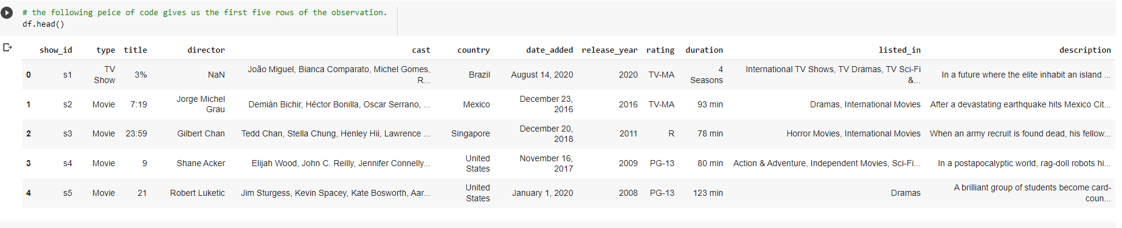
The snippet of Our dataset looks like:
The df.head() method shows us the first 5 rows of the Dataset.

Slide 8
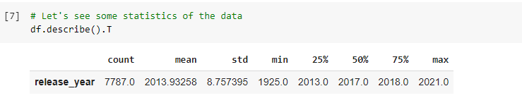
Let's look at some statistics of the Data
The Statistics of the data could be found out from an inbuilt function in pandas library called describe() .
We can see only one row because, all other rows are string values and statistics cannot be defined for string values.

Slide 9
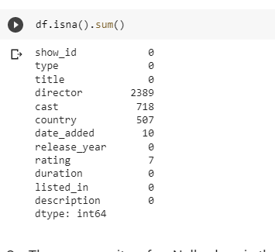
Checking for any NULL values in the whole Dataset
There are quite some null Values in our dataset
There are Null values in the features:
1. Director
2. Cast
3. Country
4.date_added
5. rating

Slide 10
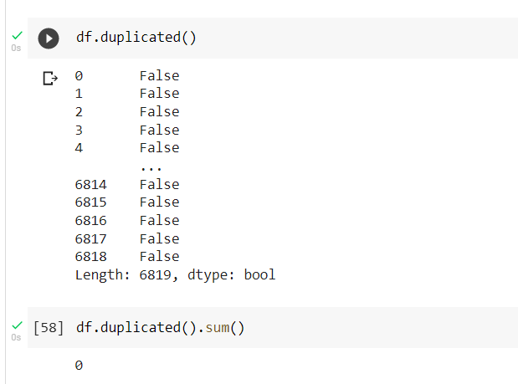
Checking for any Duplicate Values:
So, It is evident that there are no duplicate values in our whole dataset.

Slide 11
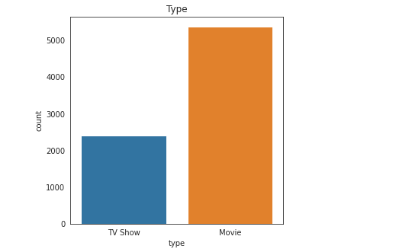
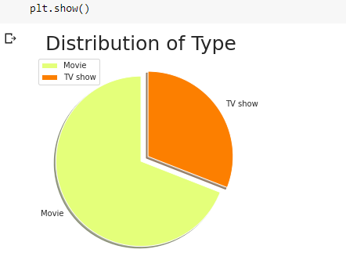
1. Checking the Distribution the variable type( movie or TV Show)
Lets begin with visualizations
So, Could be seen around 65 % of the data we have is of the type ‘Movie’ and the rest is of type ‘TV Show’.

Slide 12
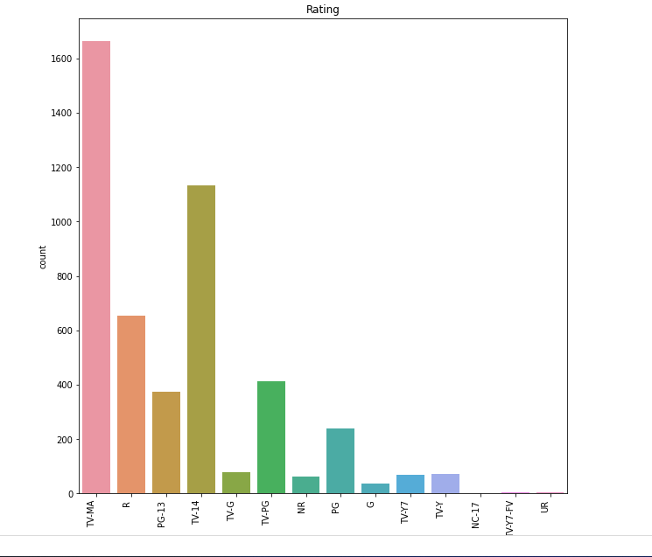
2. Lets plot the frequency of different kinds of ratings in our dataset
So, there are 14 different types of ratings in our whole dataset
On top of the list stands ‘TV-MA’ rating (TV-Mature Audience)
Last of the list are NC-17 and UR.

Slide 13
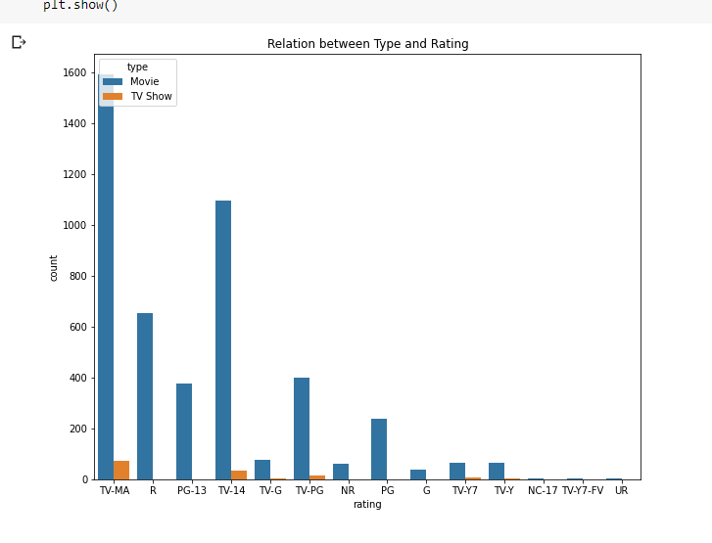
3. Relation between Type and Rating
The above picture shows the relation between type (TV show and Movie) and their respective ratings.

Slide 14
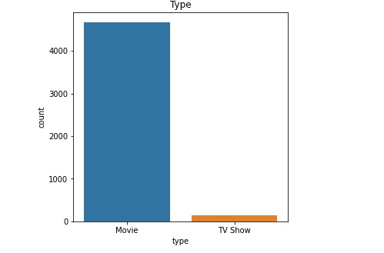
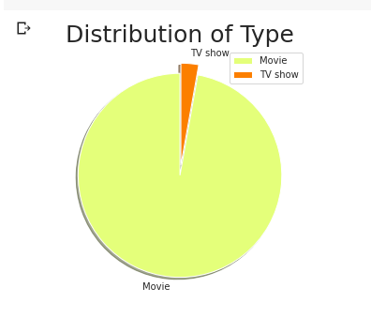
3. Let’s plot the distribution of the data after dropping null Values
As we can see, We have lost a lot of data
Above 2000 rows to be precise
And also we have lost a lot of data from the type “TV show” which can hamper our future predictions

Slide 15
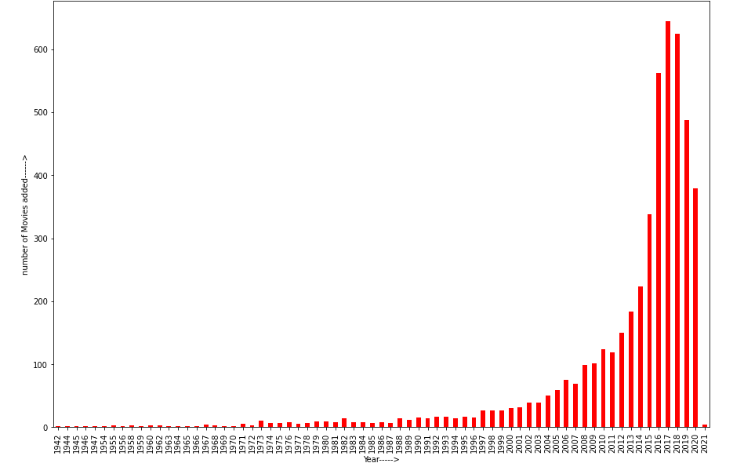
4. Plotting the frequency of number of titles released per year
The number of titles generated per year increases from the year 1942 till 2017 .
Then we can see a gradual decrease in the number from 2019 ,whose credit goes to Covid-19.

Slide 16
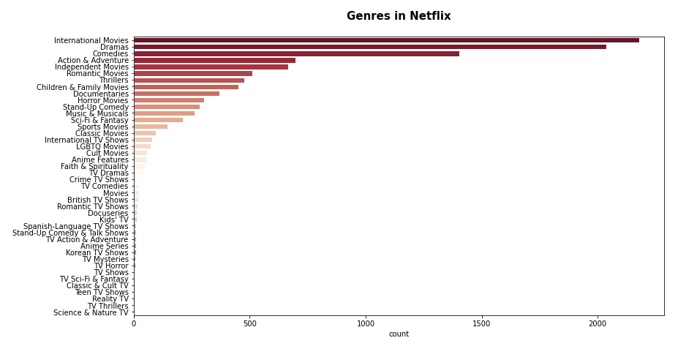
5. Plotting the frequency of the different Genres in the titles released in Netflix
Plotting the frequency, the Genre “International Movies” stands on first followed by ‘Dramas” and “Action and Adventures”.

Slide 17
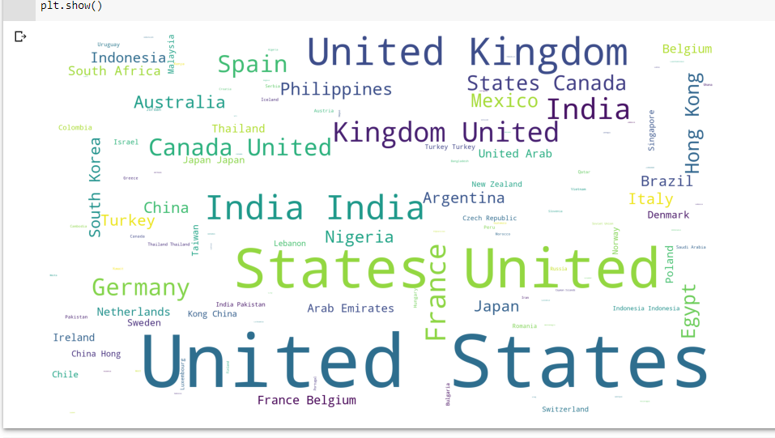
6. Plotting a Word Cloud of different Countries
A Word Cloud is an image composed of words used in a particular text or subject, in which the size of each word indicates its frequency or importance..
AS it can be seen from this picture, United states Comes first and next on list is India and United Kingdom

Slide 18
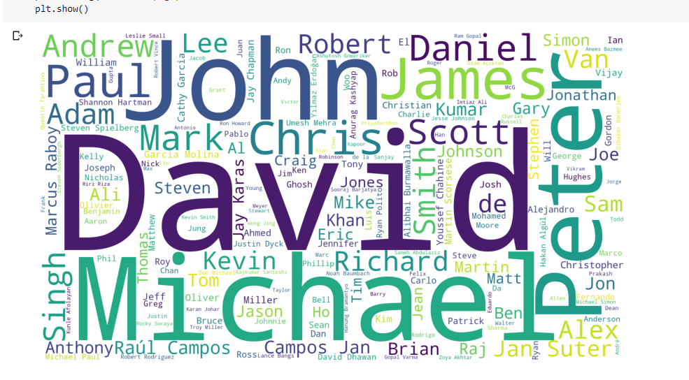
7. Plotting Word Cloud of different Directors
Plotting a Word Cloud of directors we, find out that David is the most common name that comes up for a director and following that name is John, Michael and peter.

Slide 19
Data Modelling
1. Natural Language Processing(NLP):
Natural language processing (NLP) is a subfield of linguistics, computer science, and artificial intelligence concerned with the interactions between computers and human language, in particular how to program computers to process and analyze large amounts of natural language data.
The goal is a computer capable of "understanding" the contents of documents, including the contextual nuances of the language within them.

Slide 20
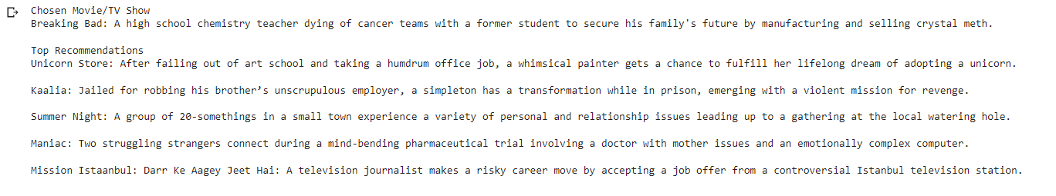
Testing NLP:
1. For the TV Show “Breaking Bad”
The NLP(Natural Language Processing) gives us the recommendation for the TV Show ‘Breaking Bad’ are: “ Unicorn Store”, “Summer Night”, “Maniac”, “Mission Istanbul” and “Kaalia”.

Slide 21
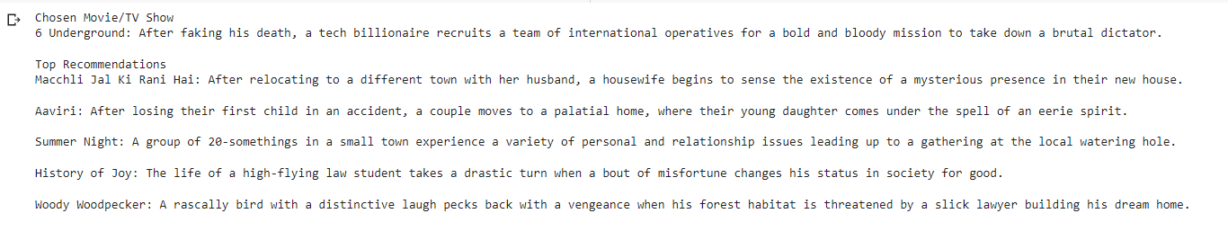
2. for the movie “6 Underground”
The NLP(Natural Language Processing) gives us the recommendation for the movie “6 underground” , are: “machali Jal ki rani Hai”, “aaviri”, “Summer Night”, “History of Joy”, “Woody Woodpecker”
The Recommendations provided by the model NLP are not up to the mark and lets proceed to our next model “ K-means” Clustering

Slide 22
2. K-Means Clustering
k-means clustering is a method of vector quantization, originally from signal processing, that aims to partition n observations into k clusters in which each observation belongs to the cluster with the nearest mean (cluster centers or cluster centroid), serving as a prototype of the cluster.
k-means clustering minimizes within-cluster variances (squared Euclidean distances)

Slide 23
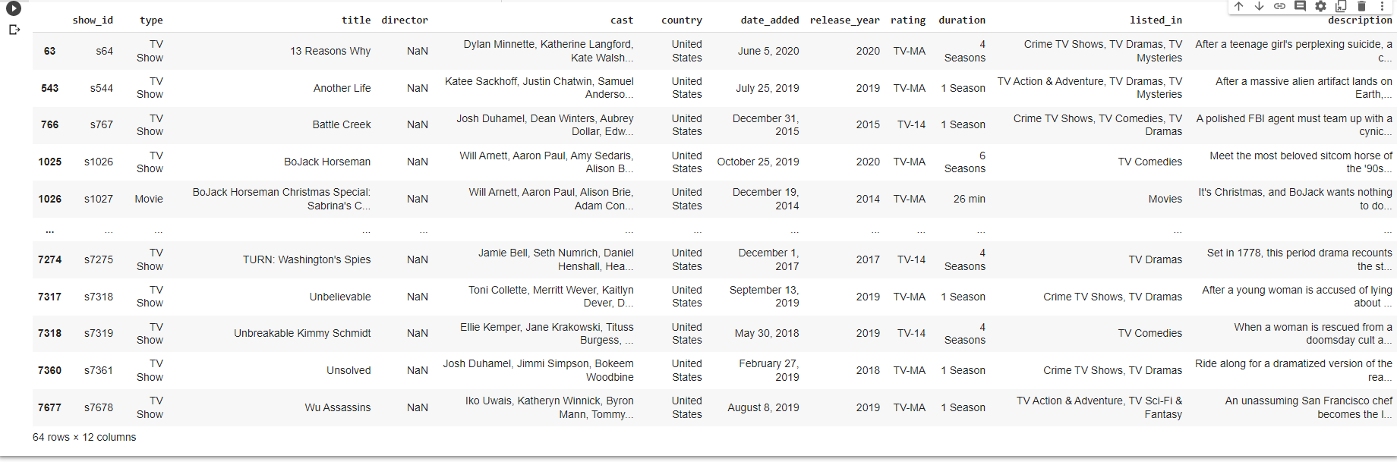
Testing K-Means Clustering
1. Testing the model K-means Clustering for the same set of titles
The above picture shows prediction for the TV show “ Breaking Bad”

Slide 24
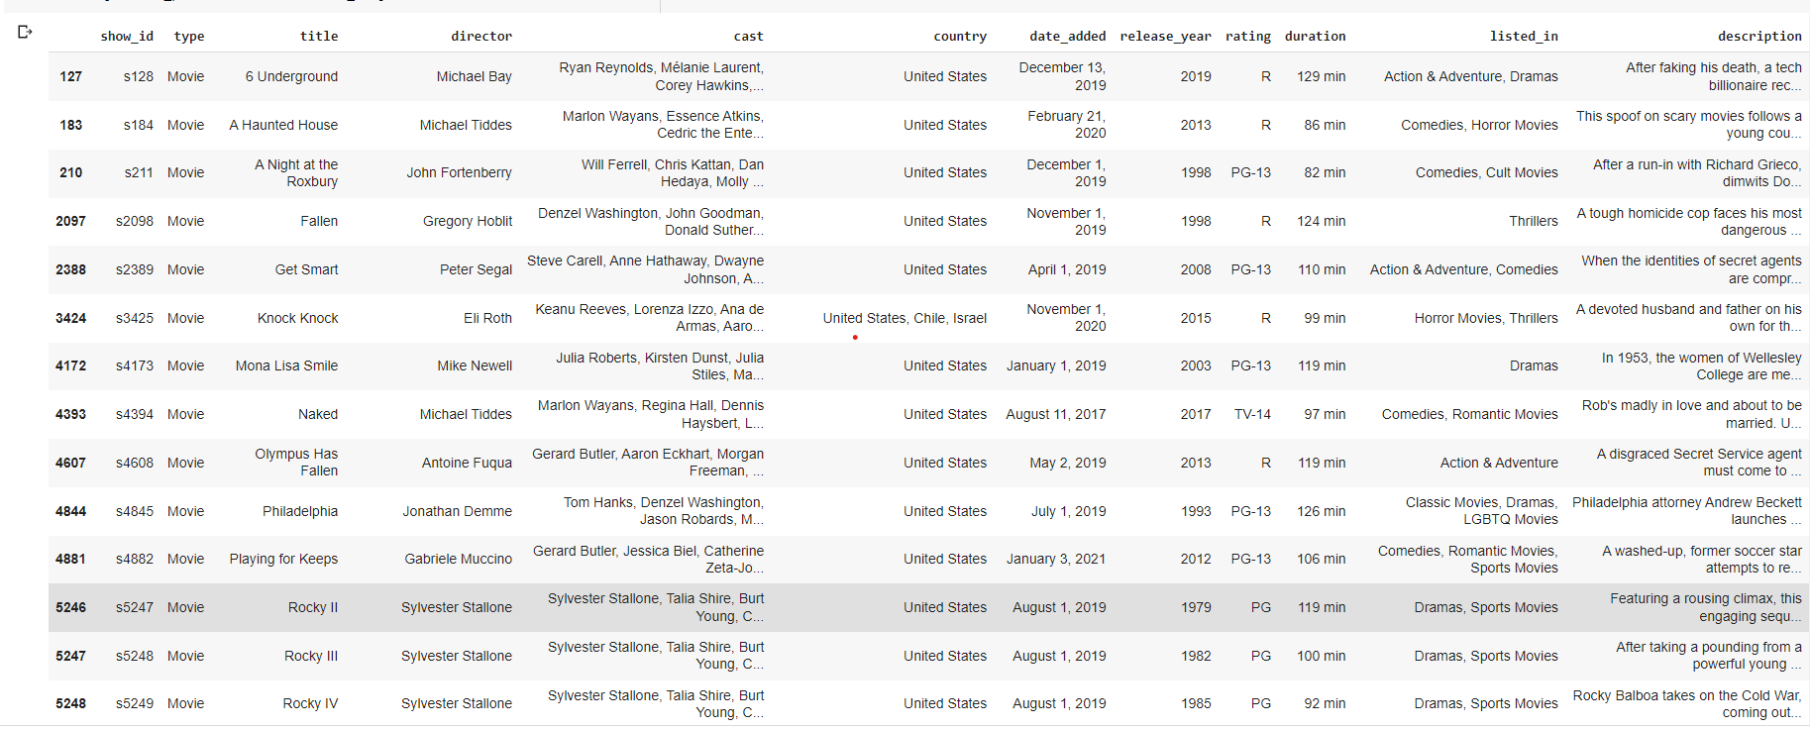
The above picture shows the recommendation for the movie “6 underground” from the model K-means Clustering.
The recommendations from the K-means Clustering are very close to the movie titles we produced.
So, K-means Clustering is the model we would like to choose as final model for further predictions.

Slide 25
Conclusion:
The Experiment I chose is to Cluster the movie recommendations from Netflix Movie and TV shows dataset.
The dataset has 12 features on offer .
We applied 2 Machine Learning Algorithms namely :
1. Natural Language Processing(NLP)
2. K-means Clustering
According to the recommendations seen from both the models, the results from the K-means model were very close to the films in terms of the description of the movie.

